Slide 1
Pup Care
React + Nest.js project

Slide 2

@StanimiraVlaeva
Google Developer Expert for Angular
Developer @VMWare Clarity
ex NativeScript Core team

Slide 3
Technologies

Slide 4
Frontend
React
Twitter Bootstrap
HTML5 + CSS3

Slide 5
Backend
Nest.js
MongoDB
JSON Web Tokens
Passport

Slide 6
Functionality

Slide 7
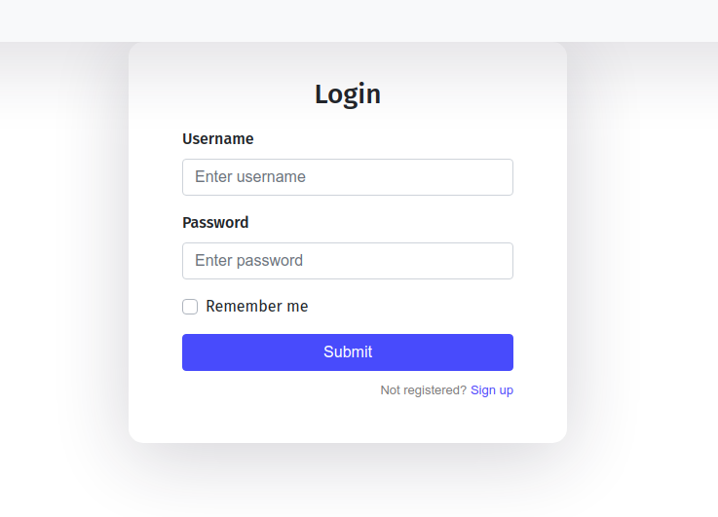

Slide 8
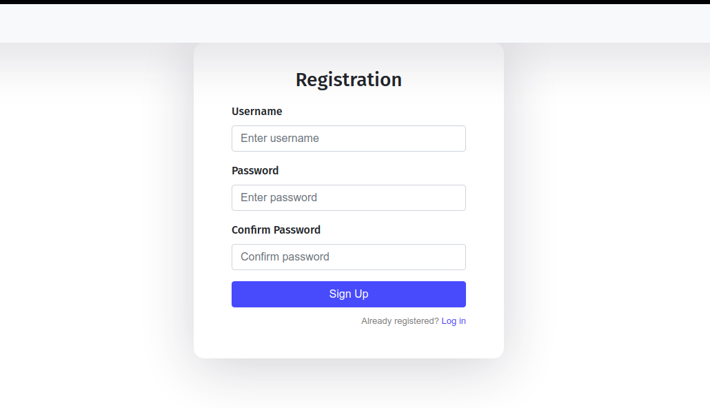

Slide 9
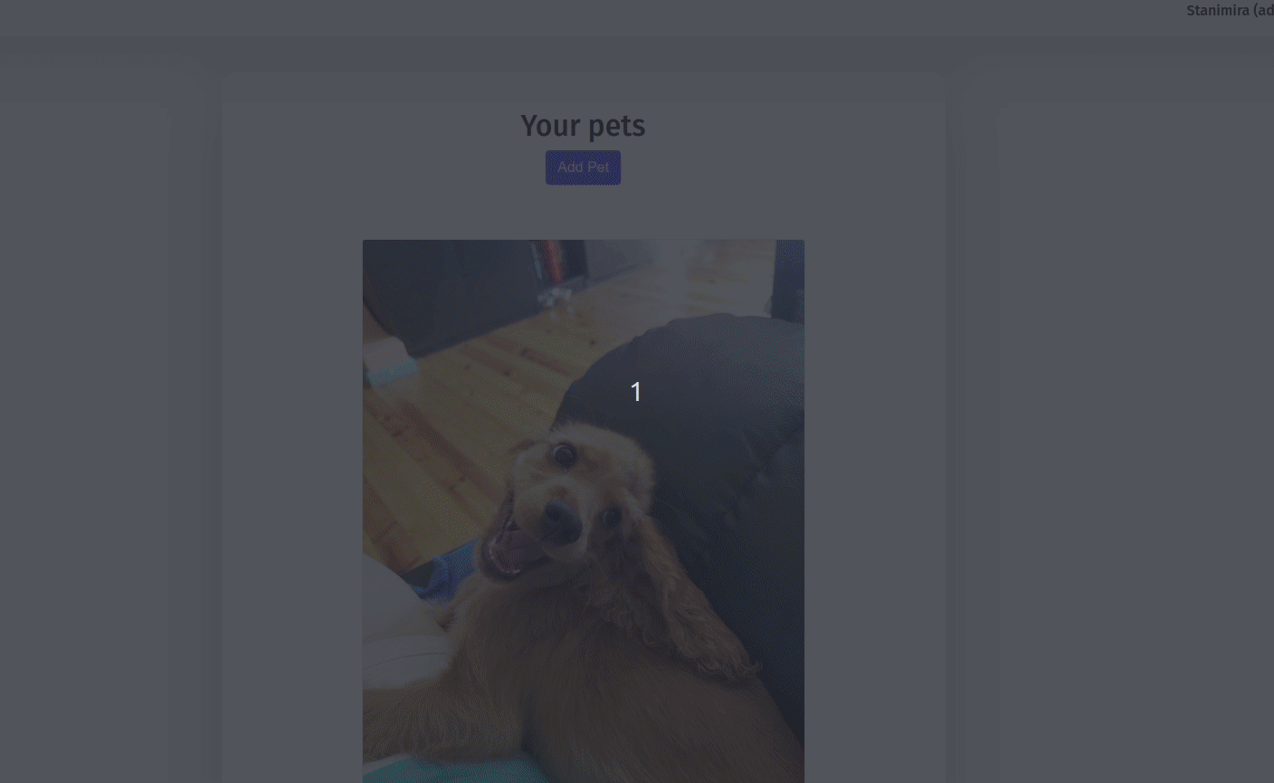

Slide 10
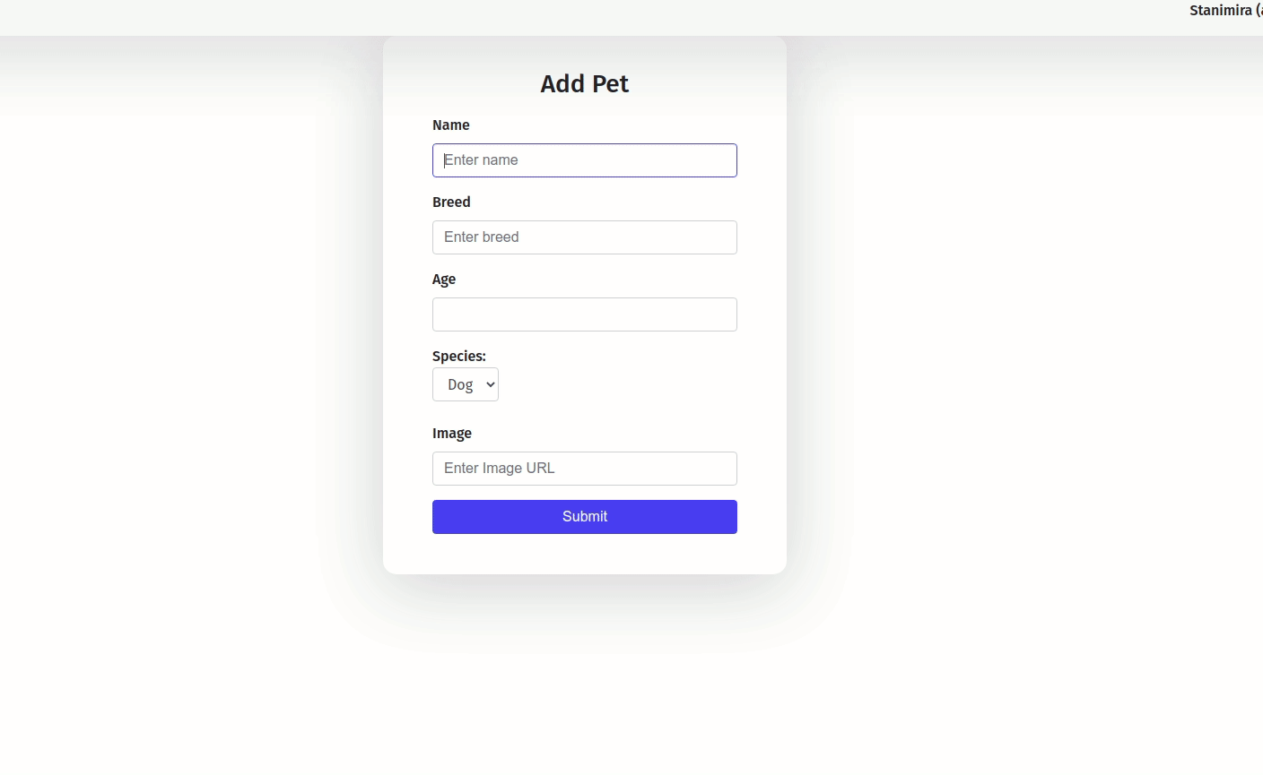

Slide 11
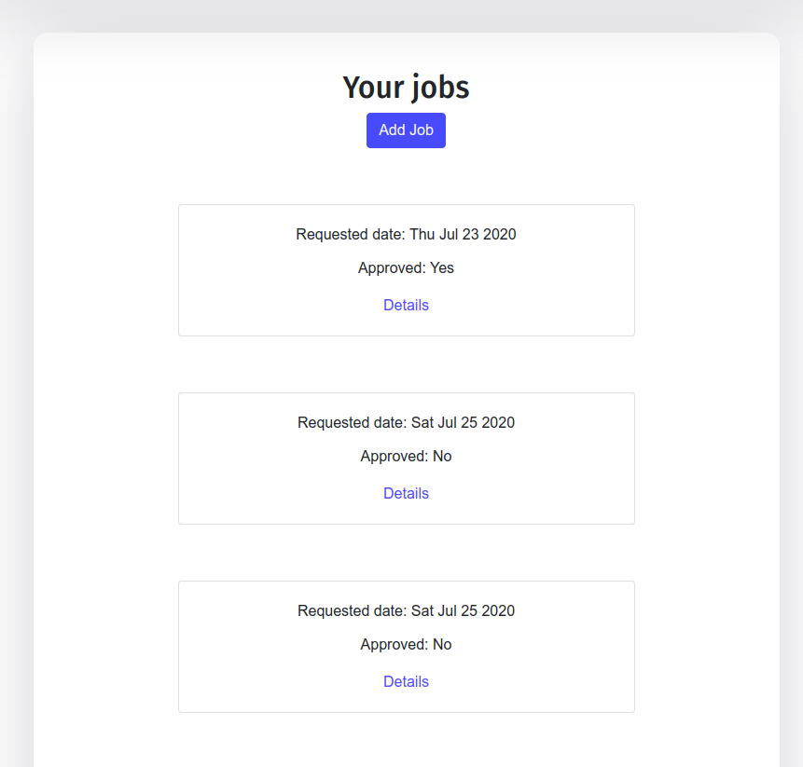

Slide 12
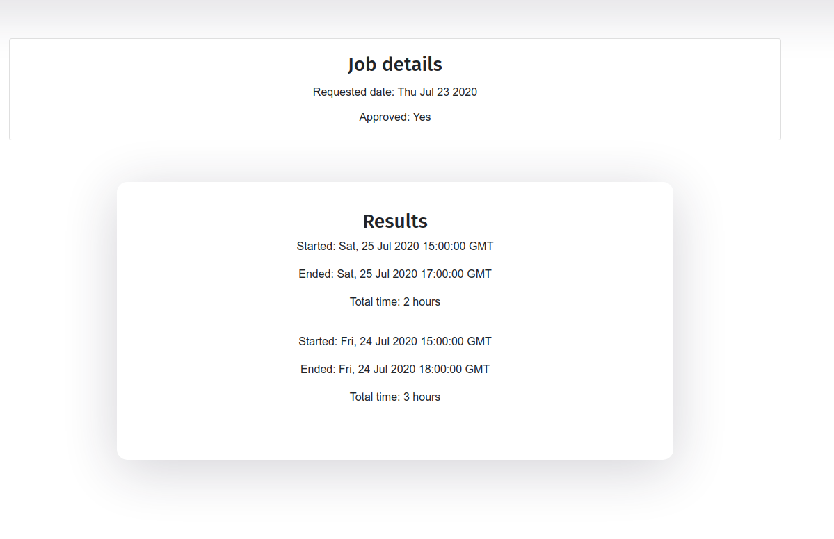

Slide 13
